Slide 1
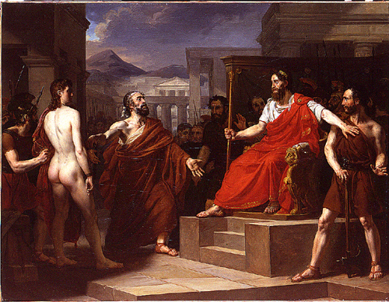
Secure Software Components Leveraging the seL4 Microkernel
DARPA I2O SBIR topic 151-003 Phase II contract D15PC00175
initiated by John Launchbury / managed by Ray Richards
performed by Stu.Card@critical.com, Steve Chapin chapin@syr.edu et al
with consulting support from Genode Labs & Data61
based on our prior SBIR/STTR development of Distributed Attestation for Mobile, Multicast & Multi-Operator Networks (DAM3ON)
Attestation of trustworthiness
of Damon & Pythias in Greek myth
painting by Eloi-Firmin Féron
lo-res scan of unknown origin, uploaded 2013, Public Domain, https://commons.wikimedia.org/w/index.php?curid=30306878
This research was developed with funding from DARPA, AFRL/RI, AFOSR & OSD. The views, opinions and/or findings expressed are those of the authors and should not be interpreted as representing the official views or policies of the DoD or the U.S. Government.
Cleared by DARPA as DISTAR case 29869.
briefing outline
the Syracuse Assured Boot Loader Executive (SABLE)
secure boot
trusted boot
formal verification
the Genode operating system framework
dynamic workloads
strongly isolated VMs
mixed trust model verification
prototypes
distributed repo AAA on x86-64 w/TPM
Genode / seL4 on real ARM hardware
applications
remote spectrum analyzer
network gateways
run-time safety/security coprocessors

Slide 2
SABLE
S/W utilizes H/W “root of trust”
Trusted Platform Module (TPM chip) with “hardware protected capabilities”
24 Platform Configuration Registers (PCRs) into which 160 bit hashes are “extended”
“seal” critical data (e.g. keys) to trusted state / unseal only in repeat of that state
SABLE uses both non- & -resettable PCRs to enable nested boot & Flicker
Dynamic Root of Trust for Measurement (DRTM) processor instructions
AMD skinit / Intel senter reset system to safe state & “late launch” Secure Loader Block
code in SLB is measured (hash extended into PCRs), measures & launches other code
secure boot precludes untrusted code gaining access to sensitive code, data, keys, etc.
trusted boot enables subsequent local & remote attestation of system configuration
SABLE written to facilitate independent formal verification
Only capability-based secure boot of which we are aware
if TCB measurements wrong, not just “will not complete boot”, but also “cannot complete boot”
essential crypto keys derived from: PCR values; operator input; TPM hardware-protected capability operation
Full Disk Encryption (FDE) of not only ‘/’ (root) but also ‘/boot’ (kernel, initramfs)

Slide 3
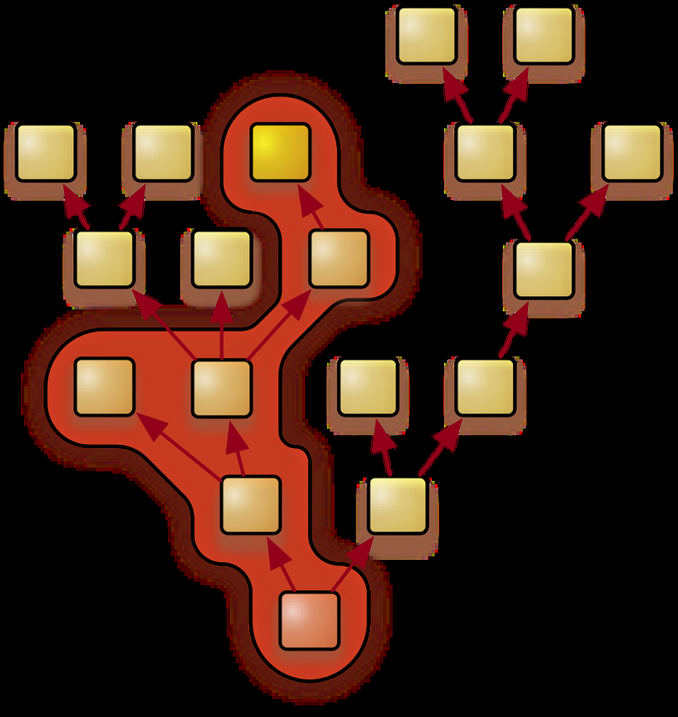
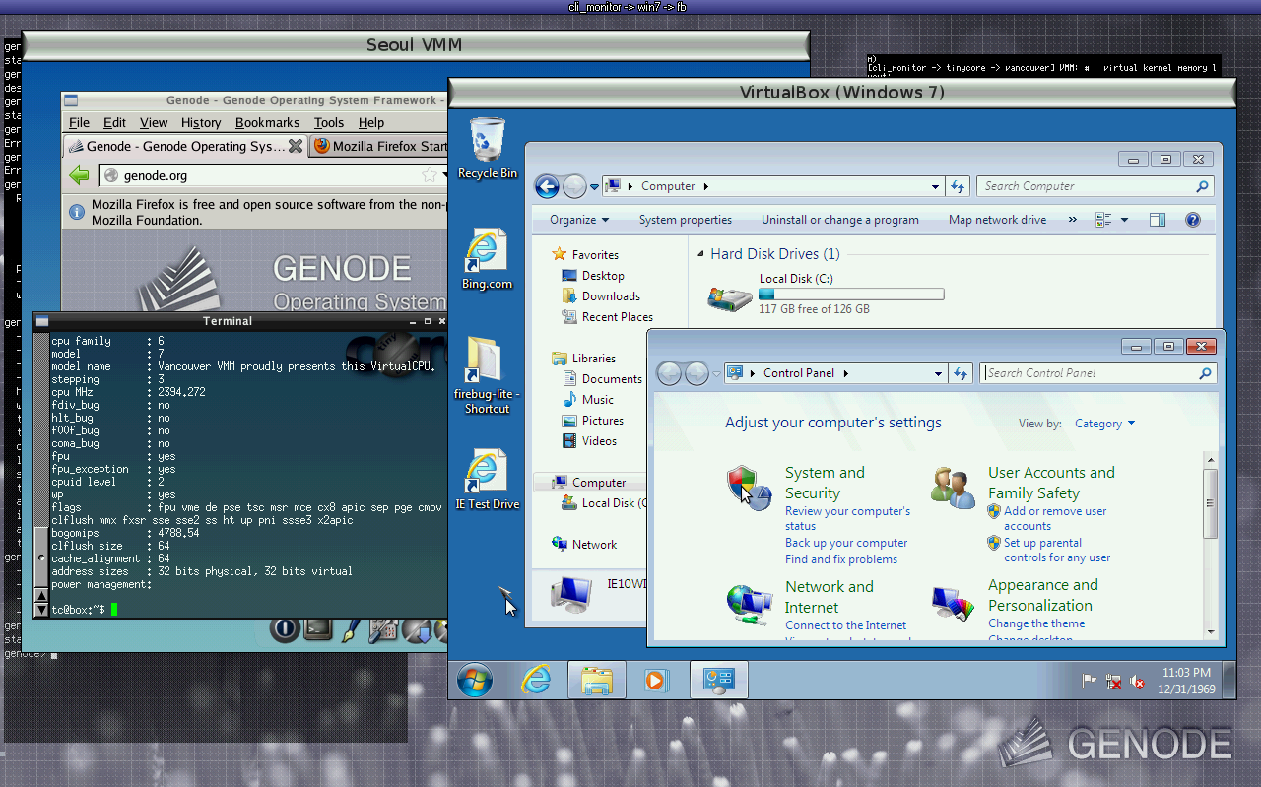
Least privilege: capability-based security
Mixed criticality
construct special-purpose OSes
isolated components, app-specific TCBs
Dependability
lightweight (~4 MB)
account, trade, & track physical resources
Scalability & Cross-Platform
recursive system structure
host existing OSes, VMMs
x86, ARM [TrustZone]
Open Source Community Support
source code at GitHub
several microkernels inc. seL4
over 100 ready-to-use components
Genode extends seL4 ecosystem &
seL4 handles several issues for Genode, esp.
memory management
inter-component communications
formal foundation for capabilities
Genode resources dynamically allocated & accessed via capabilities strictly following process tree
TinyCore Linux on Seoul VMM,
MS Windows 7 on VirtualBox;
both concurrently on Genode!

Slide 4
seL4 is a Beautiful House (Talking Heads Motivate Secure Boot)
And you may find yourself in a beautiful house,
with a beautiful wife
And you may ask yourself,
"Well... how did I get here?”
— Talking Heads
“Once in a Lifetime”

Slide 5
Secure Boot

Slide 6
Secure Boot

Slide 7
Secure Boot

Slide 8
Secure Boot

Slide 9
Secure Boot
Boot if and only if
We can mutually authenticate System and User
We are booting a “blessed” configuration

Slide 10
Talking Heads On Integrity Checking
And you may tell yourself, "This is not my beautiful house"
And you may tell yourself, "This is not my beautiful wife"
— Talking Heads
“Once in a Lifetime”

Slide 11
TPM, Hash, & Hash Chaining
Trusted Platform Module: tamper-resistant crypto engine w/secure storage
Hashing an object makes malicious changes impractical (“measure”)
Chaining together sequences of hash values protects configuration

Slide 12
seal(), unseal(), and DRoT
seal(): encrypt data decrypt key and PCR state
unseal(): decrypt data using key and PCR state
Dynamic Root of Trust: reset system, put 0 in PCR.

Slide 13
seal(), unseal(), and DRoT
seal(): encrypt data decrypt key and PCR state
unseal(): decrypt data using key and PCR state
Dynamic Root of Trust: reset system, put 0 in PCR.

Slide 14
seal(), unseal(), and DRoT
seal(): encrypt data decrypt key and PCR state
unseal(): decrypt data using key and PCR state
Dynamic Root of Trust: reset system, put 0 in PCR.

Slide 15
seal(), unseal(), and DRoT
seal(): encrypt data decrypt key and PCR state
unseal(): decrypt data using key and PCR state
Dynamic Root of Trust: reset system, put 0 in PCR.

Slide 16
seal(), unseal(), and DRoT
seal(): encrypt data decrypt key and PCR state
unseal(): decrypt data using key and PCR state
Dynamic Root of Trust: reset system, put 0 in PCR.
Can now seal/unseal data with this PCR value

Slide 17
Talking Heads on Proving Correctness
And you may ask yourself, "Am I right?
Am I wrong?"
And you may say to yourself,
"My God! What have I done?"
— Talking Heads
“Once in a Lifetime”

Slide 18
Implementation and Verification of the SABLE Heap Allocator
Monadic Model
Formal Proofs
We verify the code using Isabelle/HOL→
a proof assistant for higher order logic.
Our development process follows in a 4 step cycle:
C-SIMPL
C Source
Isabelle/HOL
We parse the C source code into a primitive imperative language called C-SIMPL, which precisely models C memory semantics
We lift the C-SIMPL code into imperative monadic code using the NICTA AutoCorres tool, which automatically proves that the C-SIMPL code exhibits the same behavior as the abstracted code
We use a Verification Condition Generator to prove Hoare triples over the alloc function
Bugs in the code will prevent us from proving Hoare triples. When this happens, we fix the bug and go back to Step 1.

Slide 19
Verified Properties of the Heap Allocator
Calls to alloc cannot fail (guaranteed to return)
Allocator correctly calculates available memory
All “free” areas really are
alloc() cannot corrupt the heap
Note: we discovered and fixed two bugs that were legitimate vulnerabilities (unsigned integer overflow and an improper comparison)

Slide 20
SABLE Proofs
First step: rewrite all functions that can fail to return exception codes; no calls to exit()
error handling in calling function
All TPM-related calls now verified
correspondence proofs between abstract and executable models
high-level proofs apply to our C code
Side note: still labor intensive; approx 20-30 LoP for each LoC

Slide 21
Genode + seL4: Mixed Trust

Slide 22
Genode
Capability based Access Control
The Core component bridges the gap between the Genode abstractions and the kernel API
On seL4, Genode caps backed by seL4 endpoint caps
seL4 integrity
In 2011, seL4 team proved integrity and authority confinement of seL4
Requires Policy, Subjective
Cannot be applied to components with excessive privileges.
wellformed
A
B
send
Control
Control
Core
NOT wellformed
Notes:
Genode’s Core component is in charge of providing operating system level services to other components. The services include memory, CPU time, and interrupt handling
integrity means that no principal (thread) can modify any kernel object for which it lacks the necessary permission.
Authority conﬁnement requires that no principal can exceed its delegated authority, as determined by a user-speciﬁed access control policy
We say the policy is not well-formed for components with excessive privileges.

Slide 23
Verification Goal & Approach
Goal: showing that Core maintains authority confinement and integrity.
Our config: multiple components (VMMs) with no communication authorities between them.
Our hybrid approach: We model Core’s behavior in the Alloy language/model checker.
we need a model of seL4 and seL4 integrity/auth confinement definitions!
sig KernelState {
cur_thread : one TCB,
…
pd_map: PageDirectory ->
PageCap -> set AccessRight
}
Notes:
We needed to model Core, and iterate over our models. Using Alloy, we could get immediate feedback (checking properties, visualizing models, errors). Theorem proving not practical.
Simplified seL4 model :
Simplifications that were informed by seL4’s invariants proofs

Slide 24
Genode Model
Model Core’s state and behavior:
Threads: page fault handler, entrypoint
Services: memory management, signals, threads, components, etc.
State can evolve in 3 ways:
Switching threads
Core thread: well-defined behavior
Non-Core thread: can do anything (make any seL4 system call)
sig GenodeSeL4State{
seL4_state : KernelState
// Core internal state:
regionMap_mapping :
set (DataSpace + RegionMap)
-> set RegionMap
...
}
Notes:
(remember, Core is trusted!)
(non-Core threads are not trusted, they are free to do anything!)

Slide 25
Verification
We need a set of Genode invariants first!
Then we can verify authority confinement and integrity
check auth_confined{
all s, s': GenodeSeL4State{
let abs = core_view_abs[s] |
g_invariants[s] =>
pa_refined[policy, abs, s .seL4_state] =>
evolve[s, s'] =>
pa_refined[policy, abs, s'.seL4_state]
}
}
This shows that Core indeed satisfies integrity and auth confinement
Notice evolve. A bit of sanity check!
plus to verify that our modified definitions of integrity and authority confinement are still satisfied by seL4
Notes:
Examples of genode invariants:
all the threads in the system belong to a protection domain that Core knows about: g_invariants_all_tcbs_accounted_for
all SignalSource objects in Core point to seL4 notification capabilities (and not capabilities to other objects): g_invariants_signalSource_objs_valid predicate.
Notice evolve, we are verifying both Core and non-Core threads. A bit of sanity check! (plus to verify that our modified definitions of integrity and authority confinement are still satisfied by seL4)

Slide 26


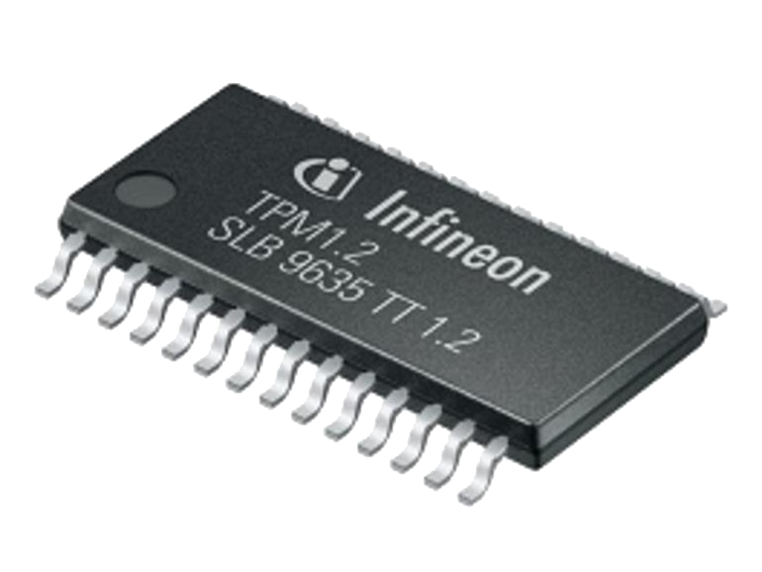




DAM3ON’s XACML/SAML based AAA (Attestation, Authentication, Authorization, Access Control, Attribution, Accounting & Audit, initially for a distributed repository supporting a publish-subscribe messaging system)
On Boot
On Attestation
Late Launch
ABLE
Extend
Measurements
PCR’s
SABLE
Provide Attest. Info
Request Attestation
Request Quote
Signed
Quote
+
XACML Request
XACML Response
+
Resource
Chrome Extension
Chrome Extension

Slide 27
Attestation
Done using a “TPM quote” from a TPM chip
A TPM quote is a cryptographic signature on an arbitrary set of PCR values as they currently exist on a machine (PCR being registers for measurements done by the TPM). A quote also includes a nonce, and is signed by an AIK (Attestation Identity Key).
When attesting:
Quote is validated & verified by server (PEP)
After validation & verification, list of binaries comprising the quote are known, which are then used later on to look up known properties about them. If no properties are known, user is prompted to provide a URL to a certificate that asserts properties.
PEP then forms a request as usual, but now including a list of binary hashes, and sends to PDP
PDP, by means of a PIP (Policy Information Point) looks up which security properties are associated with each binary, which in turn is then used to see if a user satisfies that portion of policy

Slide 28
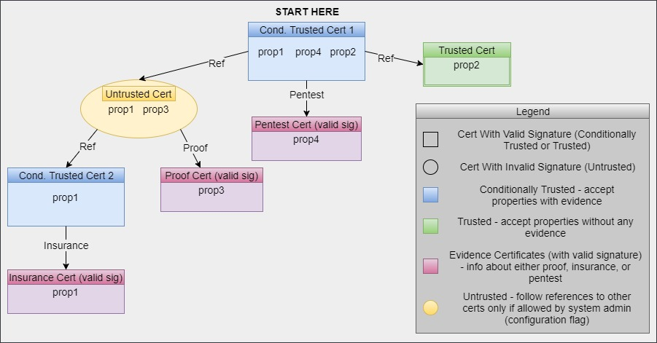
Walk the Security Property Certificate Tree to Determine Whether Access Policy is Satisfied

Slide 29
Genode / seL4 / ARM
There is as yet no intersection between Data61 & Genode Labs supported ARM boards, but SabreLite & WandBoard Quad are similar, so we (mostly Yevgeny Lavrov) ported Genode to the former & seL4 to the latter to get a Genode / seL4 stack on both.
A Trusted Execution Environment (TEE) on ARM is essential, but
TPMs are generally lacking on ARM boards
TrustZone could be used to implement Virtual TPMs, but current TZ is limiting & seems likely to evolve towards something like Intel SGX (with multiple enclaves & main memory encryption)
Extending the open source ARM boot firmware to create non-interfering vTPMs (1 per VM) looks promising, but we deferred it until we see where TrustZone is going
RISC-V offers an interesting alternative (or adjunct)

Slide 30



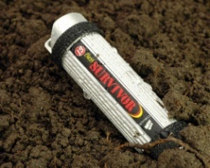

Current Transition & Future R&D in Mixed-Trust Systems
Commercial product development clients
Remote spectrum analyzer (Xilinx Zynq Ultrascale+ ARM based)
OTT/IPTV mesh Content Delivery Network gateway (AMD x86-64 based)
IR&D
DTN/IP/SDR gateway [for B-LOS emergency networking]
My Portable Digital Life (see graphic below) [w/cryptocurrency wallet]
Seeking sponsors
multi-core / multi-ISA (e.g. ARM & RISC-V) to mitigate design vulnerabilities [for NSA CSFC CDS]
"conscience" run-time safety/security model compliance monitor [for safe UAS in the NAS]
autonomous cyber-physical systems w/machine learning [& mobile code]
https://opensrc.critical.com/ has our releases of Genode/seL4/ARM ports & SABLE/x86-64
contact us www.critical.com 315-793-0248 stu.card@critical.com
damaged?
lost?
stolen?
tampered?
no problem!
rapidly restore hardware,
data & services

